Slide 1
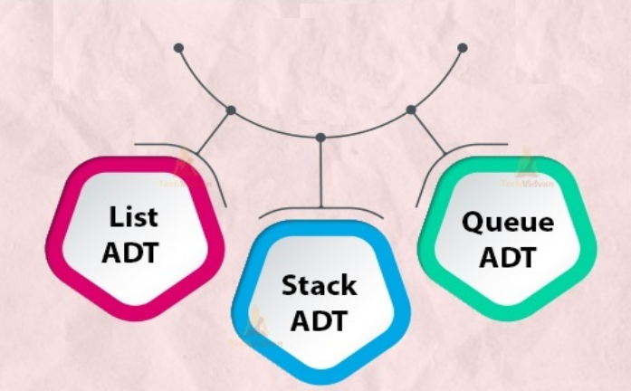
Unit 10.3 - Abstract Data Types (ADTs)
Prepared by: Koh Kian Hua

Slide 2
Objectives
After completing this unit, students should be able to:
Show understanding that an ADT (Abstract Data Type) is a collection of data and a set of operations on those data
Show understanding that a stack, queue and linked list are examples of ADTs.
Describe the key features of a stack, queue and linked list and justify their use for a given situation
Use a stack, queue and linked list to store data.
Show understanding of how to add, edit, and delete data from stacks, queues and linked-lists.
Describe how a queue, stack and linked list can be implemented using arrays.

Slide 3
Abstract Data Types
Introduction
The abstract datatype is special kind of datatype, whose behavior is defined by a set of values and set of operations.
The keyword “Abstract” is used as we can use these datatypes, we can perform different operations.
Some exampled of ADTs include: Stacks, Queues and Lists.

Slide 4
Abstract Data Types
3 Common Types of ADTs
Stack – a list containing several items operating on the last in, first out (LIFO) principle.
  Items can be added to the stack (push) and removed from the stack (pop).
  The first item added to a stack is the last item to be removed from the stack.
Queue – a list containing several items operating on the first in, first out (FIFO) principle.
  Items can be added to the queue (enqueue) and removed from the queue (dequeue).
  The first item added to a queue is the first item to be removed from the queue.
Linked list – a list containing several items in which each item in the list points to the next item in the list.
  In a linked list a new item is always added to the start of the list.

Slide 5

Abstract Data Types
Stack ADT
A stack is an Abstract Data Type (ADT), commonly used in most programming languages.
It is named stack as it behaves like a real-world stack, for example – a deck of cards or a pile of plates, etc.
We can place or remove a card or plate from the top of the stack only.
Likewise, Stack ADT allows all data operations at one end only.
We can only access the top element of a stack.

Slide 6
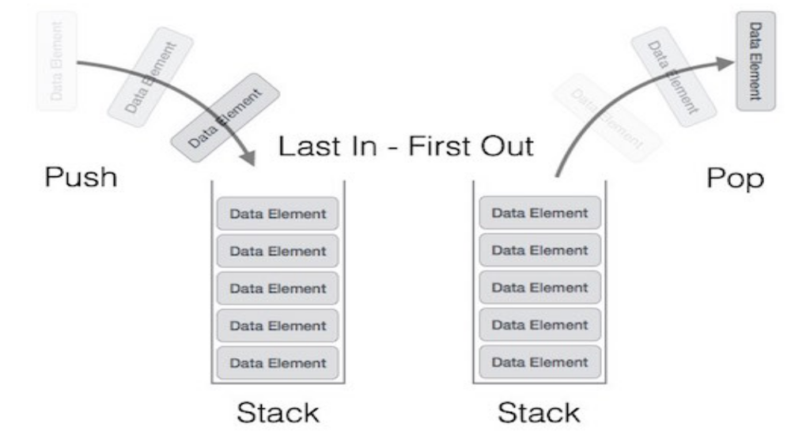
Abstract Data Types
Stack Representation
A stack is used for the following two primary operations:
Push() − Pushing (storing) an element on the stack.
Pop() − Removing (accessing) an element from the stack.
The following diagram depicts a stack and its operations −

Slide 7
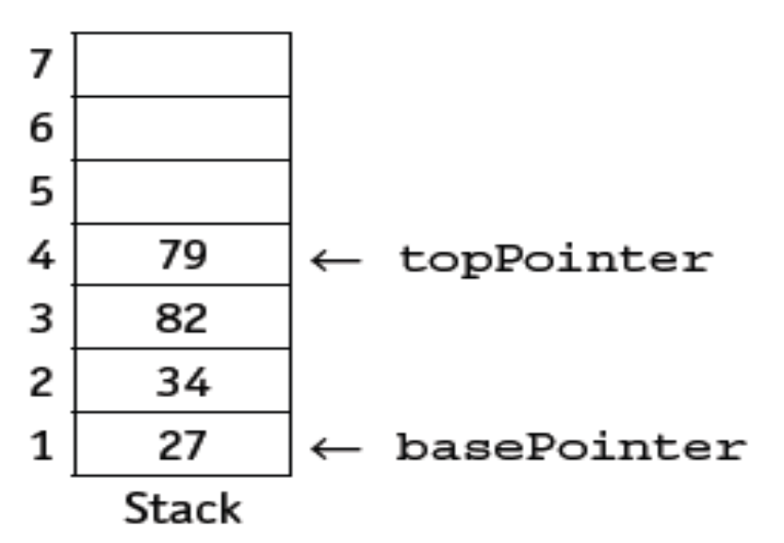
Abstract Data Types
Stack Representation
A stack uses two pointers: a base pointer points to the first item in the stack and a top pointer points to the last item in the stack.
When they are equal there is only one item in the stack.

Slide 8
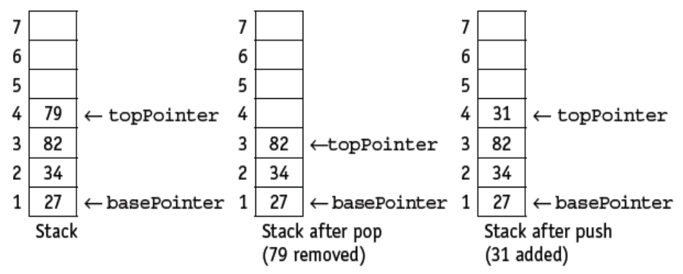
Abstract Data Types
Stack Operations
A stack can be implemented using an array and a set of pointers.
As an array has a finite size, the stack may become full and this condition must be allowed for.
The value of the basePointer always remains the same during stack operations

Slide 9

Abstract Data Types
Queue ADT
Queue is an abstract data structure, somewhat similar to Stacks.
Unlike stacks, a queue is open at both its ends.
One end is always used to insert data (enqueue) and the other is used to remove data (dequeue).
Queue follows First-In-First-Out (FIFO) methodology.
A real-world example of queue can be a single-lane one-way road, where the vehicle enters first, exits first.

Slide 10
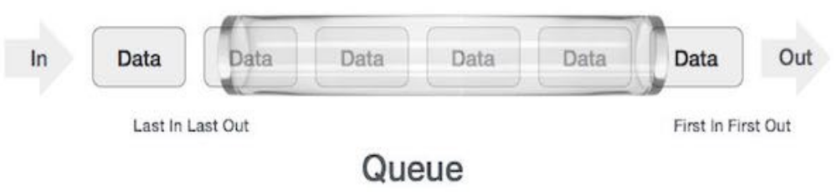
Abstract Data Types
Queue Representation
Queue operations may involve initializing or defining the queue, utilizing it, and then completely erasing it from the memory.
The basic operations associated with queues are:
  enqueue: add (store) an item to the queue.
  dequeue: remove (access) an item from the queue.
In a queue, both the ends cab be accessed.
The diagram below shows that a queue can be represented as a data structure

Slide 11
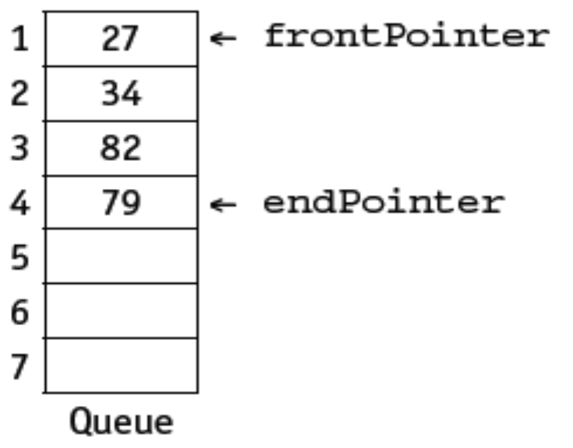
Abstract Data Types
Queue Representation
A queue uses two pointers: a front pointer points to the first item in the queue and a rear pointer points to the last item in the queue.
When they are equal there is only one item in the queue.

Slide 12
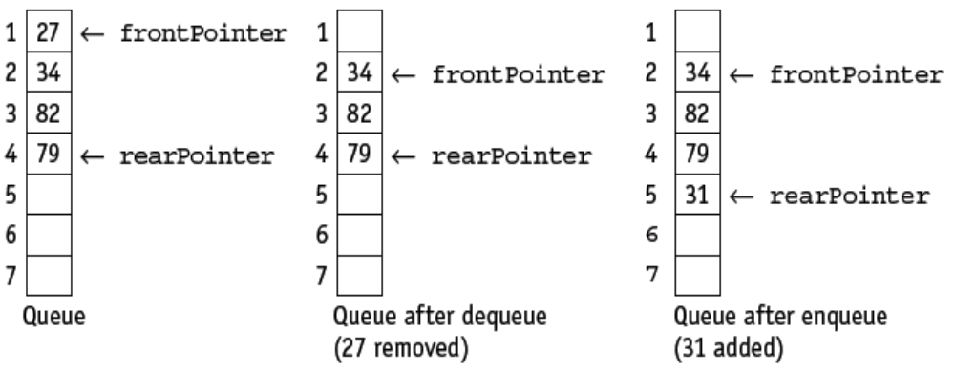
Abstract Data Types
Queue Operations
A queue can be implemented using an array and a set of pointers.
As an array has a finite size, the queue may become full and this condition must be allowed for.
The value of the frontPointer changes after dequeue but the value of the rearPointer changes after enqueue.

Slide 13
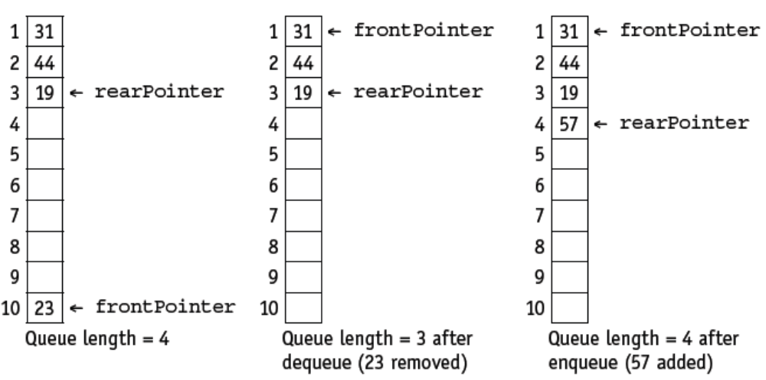
Abstract Data Types
Circular Queue Operations
When a queue is implemented using an array with a finite number of elements, it is managed as a circular queue.

Slide 14
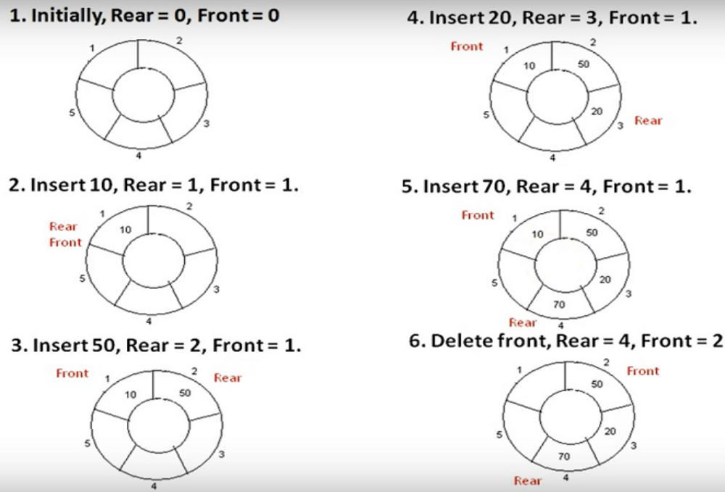
Abstract Data Types
Circular Queue Operations (queue length=5)

Slide 15
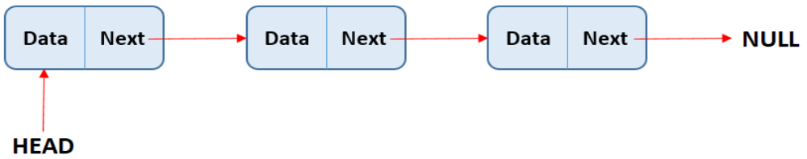
Abstract Data Types
Linked List ADT
Linked List is a sequence of links which contains items.
Each link contains a connection to another link.
Linked list is the second most-used data structure after array.
Following are the important terms to understand the concept of Linked List.
  Link: Each link of a linked list can store a data called an element.
  Next: Each link of a linked list contains a link to the next link called Next.
  LinkedList: A Linked List contains the connection link to the first link called First or Head.

Slide 16
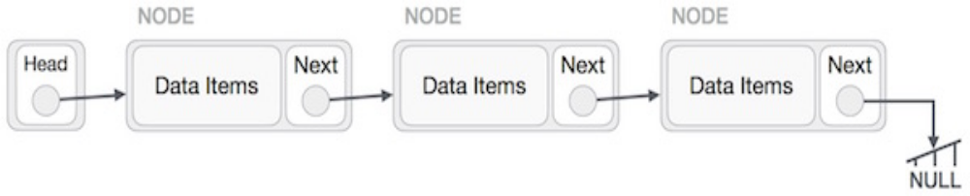
Abstract Data Types
Linked List Representation
Linked list can be visualized as a chain of nodes, where every node points to the next node.
The following are the important points to be considered:
Linked List contains a link element called first / head.
Each link carries a data field(s) and a link field called next.
Each link is linked with its next link using its next link.
Last link carries a link as null to mark the end of the list.

Slide 17
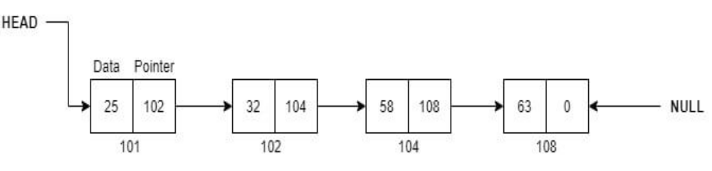
Abstract Data Types
Linked List Representation
The linked list represents the group of nodes in which each node has two parts.
The first part represents the data, and the second part represents the pointer.
The pointer part of the linked list holds the address of the next node.

Slide 18
Abstract Data Types
Linked List Operations
A linked list can be implemented using two 1D arrays, one for the items in the linked list and another for the pointers to the next item in the list, and a set of pointers.
As an array has a finite size, the linked list may become full and this condition must be allowed for.
The items can be removed from any position in the linked list, the empty positions in the array must be managed as an empty linked list, usually called the heap.

Slide 19
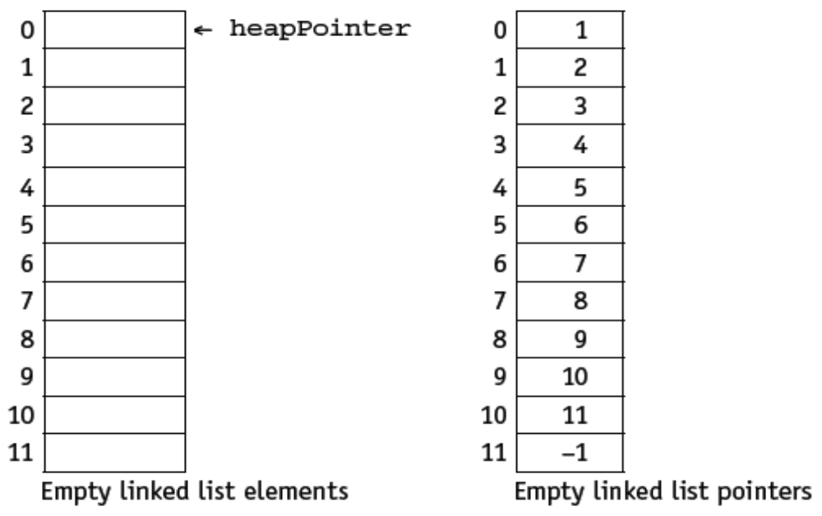
Abstract Data Types
Linked List Operations
The following diagrams demonstrate the operations of linked lists.
The startPointer = –1, as the list has no elements. The heap is set up as a linked list ready for use.

Slide 20
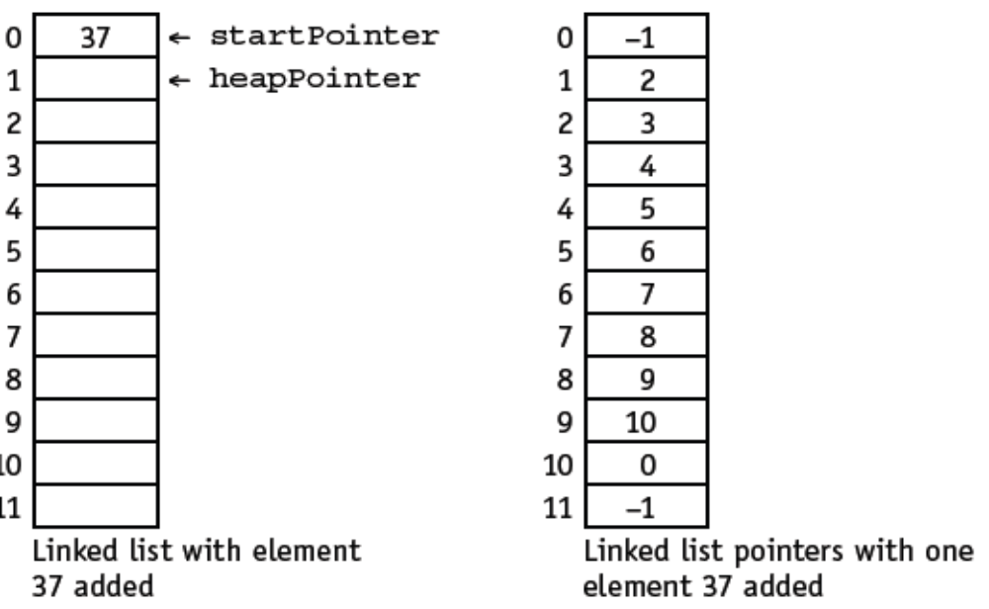
Abstract Data Types
Linked List Operations
The startPointer is set to the element pointed to by the heapPointer where 37 is inserted.
The heapPointer is set to point to the next element in the heap by using the value stored in the element with the same index in the pointer list.
Since this is also the last element in the list the node pointer for it is reset to –1.

Slide 21
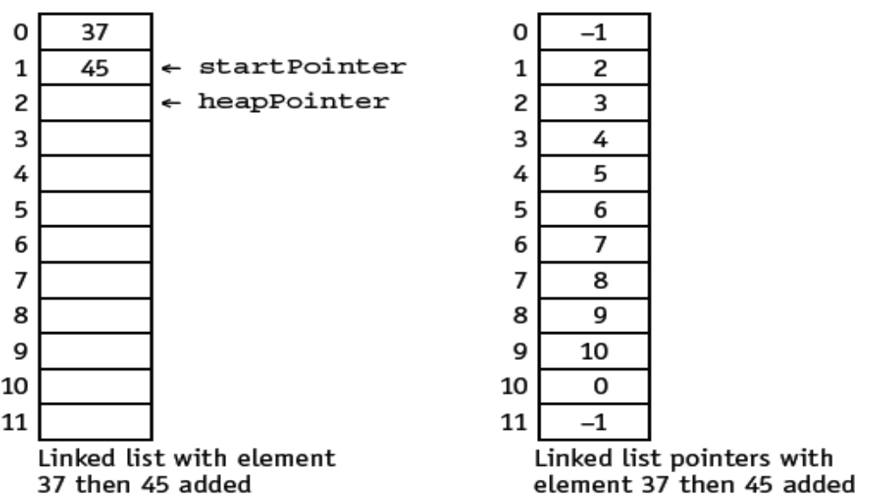
Abstract Data Types
Linked List Operations
The startPointer is changed to the heapPointer and 45 is stored in the element indexed by the heapPointer.
The node pointer for this element is set to the old startPointer.
The node pointer for the heapPointer is reset to point to the next element in the heap by using the value stored in the element with the same index in the pointer list.

Slide 22
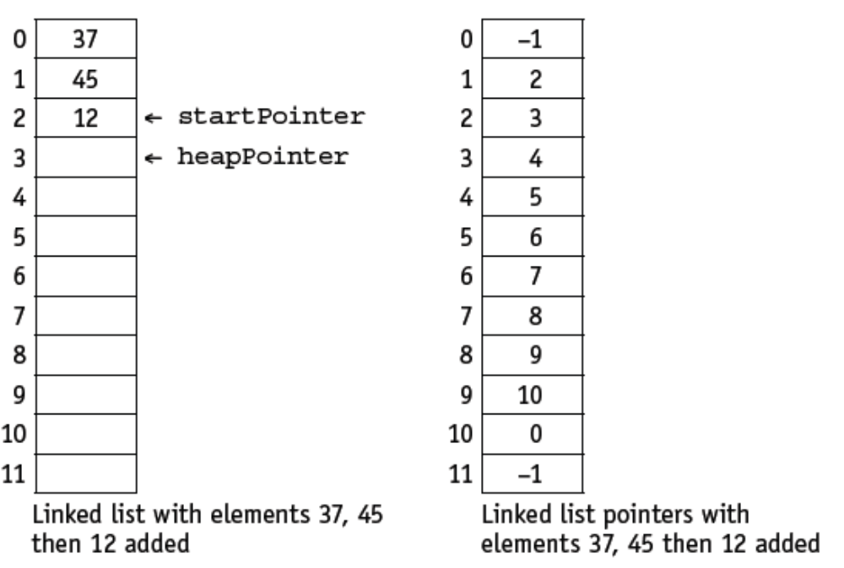
Abstract Data Types
Linked List Operations
The process is repeated when 12 is added to the list.

Slide 23
Abstract Data Types
Class Activity
Abstract data types (ADTs) are collections of data and the operations used on that data.
Explain what is meant by
a) stack
b) queue
c) linked list.

